Slide 1
Denis Grafov

Slide 2
What do I do?
Jet piloting
In my imagination
Ikea furniture delivery

Slide 3
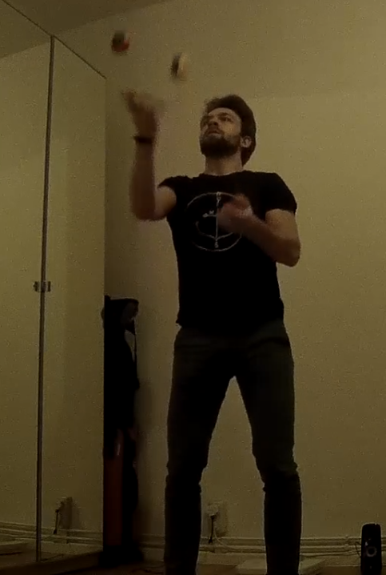
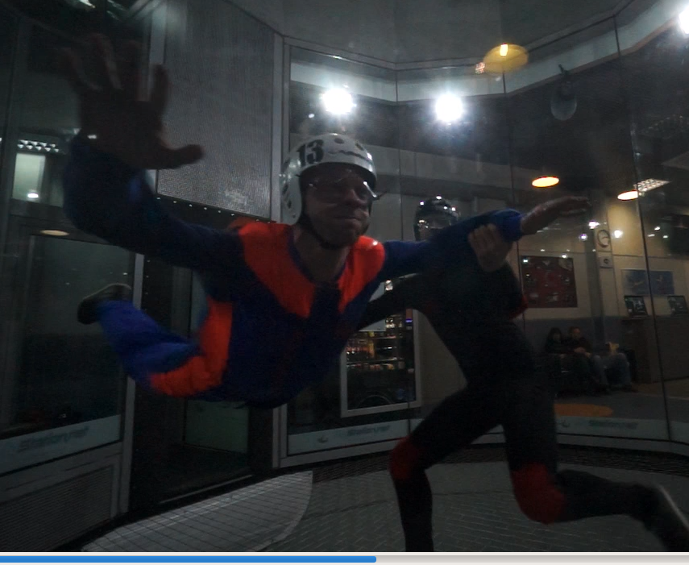
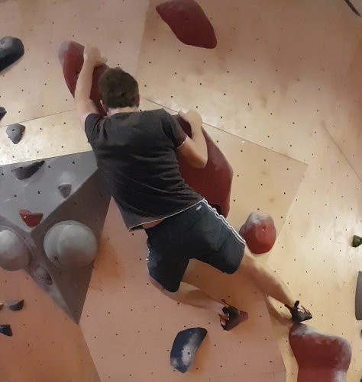
What do I do?
Random strange activities

Slide 4





How can I help you?
Second semester at ReDI
Third course at ReDI
Intro to Python, spring 2018
Intro to Robotics, spring 2018
Intro to Programming with Python, winter 2018
Software Engineer at HERE
C++
Product delivery
Software engineering processes

Slide 5
How can you contact me?
Slack
Email: denis.grafov@posteo.net
Telegram (WhatsApp): please come and ask, if you need it
LinkedIn: linkedin.com/in/denis-grafov-35417326

